Slide 1
Problem solving with fractions and decimals
Comparing and ordering fractions and decimals (positive and negative)

Slide 2
how to use Oak lessons

Slide 3
I can use my knowledge of fractions and decimals to solve problems.

Slide 4
An improper fraction is a fraction where the numerator is greater than or equal to the denominator.
Proportion is a part to whole (sometimes part to part) comparison.

Slide 5

Problem solving with fractions and decimals
Solving problems with fractions
Solving problems with decimals
Solving problems with fractions and decimals

Slide 6
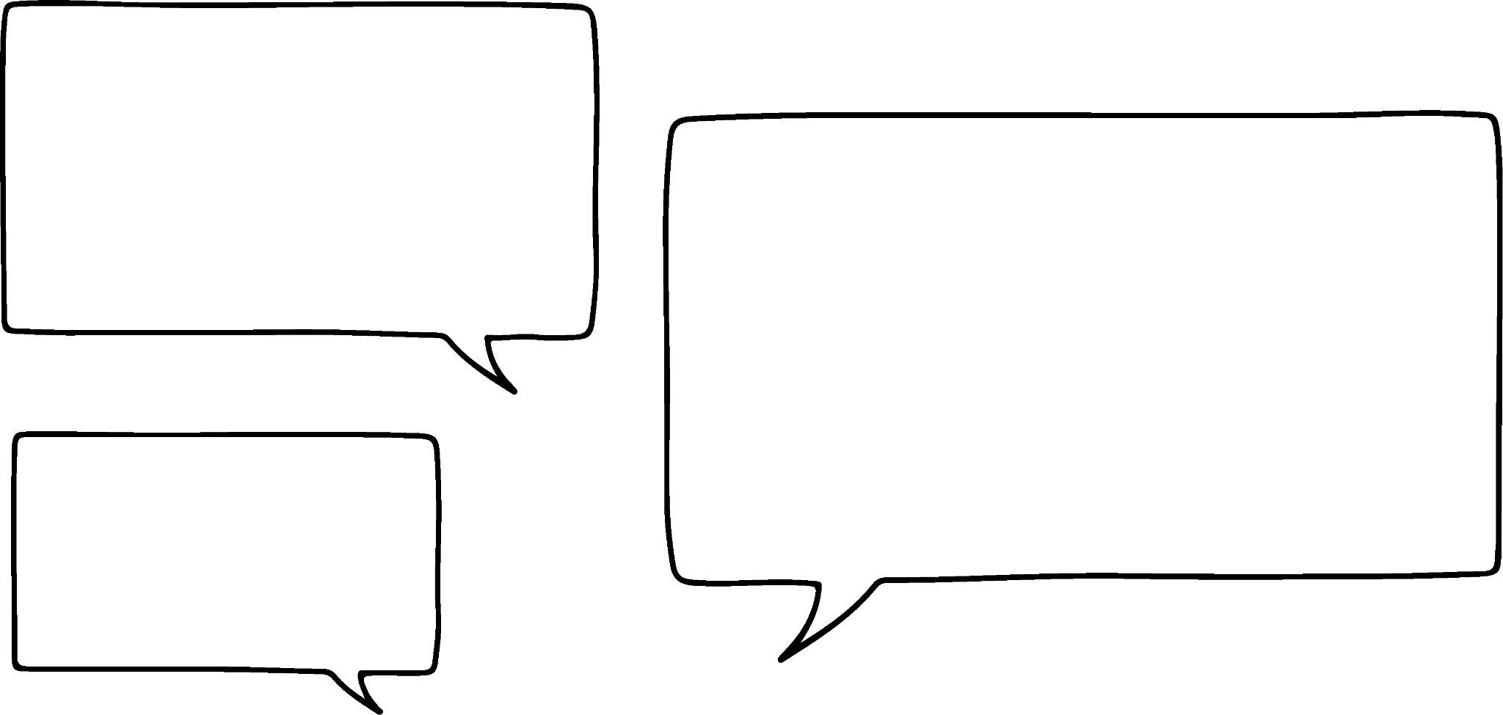
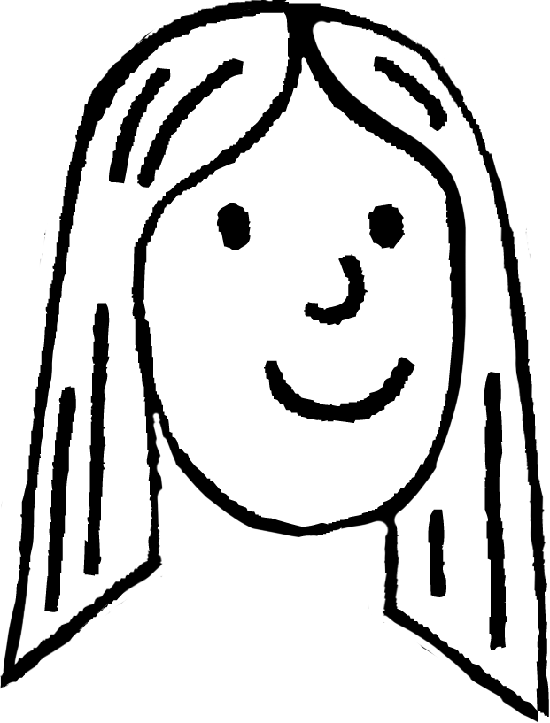
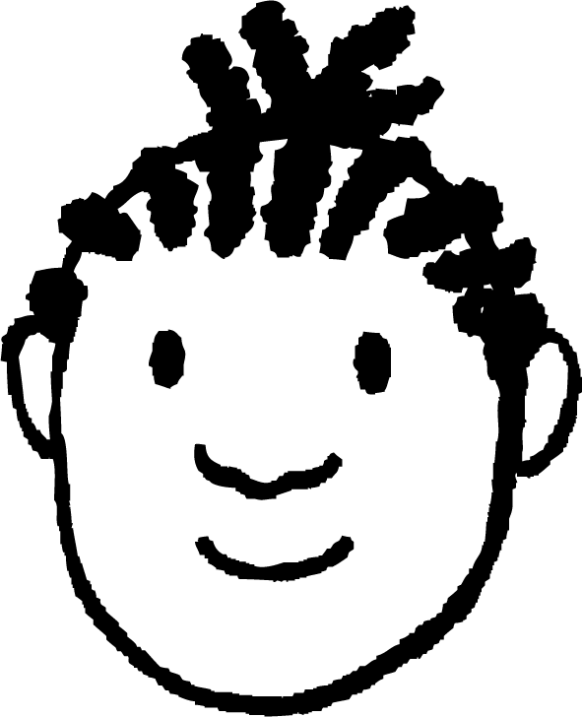
Solving problems with fractions
Arrange five different digits into this inequality.
3
5
1
>
>
2
4
Laura puts these digits into the inequality and asks Jacob to check if she is right.
That can’t be right. You have 2 improper fractions and said they are less than one.
How can Jacob check if she is right?
Oh yes, improper fractions are greater than or equal to one.
Laura
Jacob

Slide 7
Solving problems with fractions
Arrange five different digits into this inequality.
3
2
1
>
>
4
5
How can Laura check if he is right?
I can change them into decimals to check if you are right.
Let me try.
Laura
Jacob

Slide 8
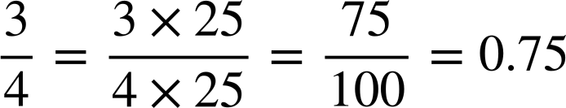
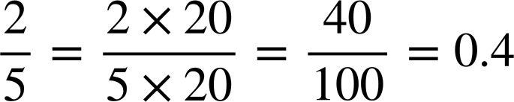
Solving problems with fractions
Arrange five different digits into this inequality.
3
2
1
>
>
4
5
I can change them into decimals to check if you are right.
You were right. Well done!
1 > 0.75 > 0.4
Laura
Jacob

Slide 9
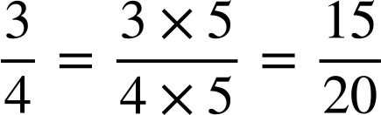
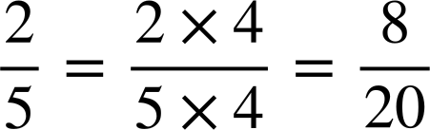
Solving problems with fractions
Arrange five different digits into this inequality.
3
2
1
>
>
4
5
Yes we could. Let’s check using that method. The LCM of 4 and 5 is 20.
We could have converted the fractions so that they had a common denominator.
Laura
1 > >
Jacob

Slide 10
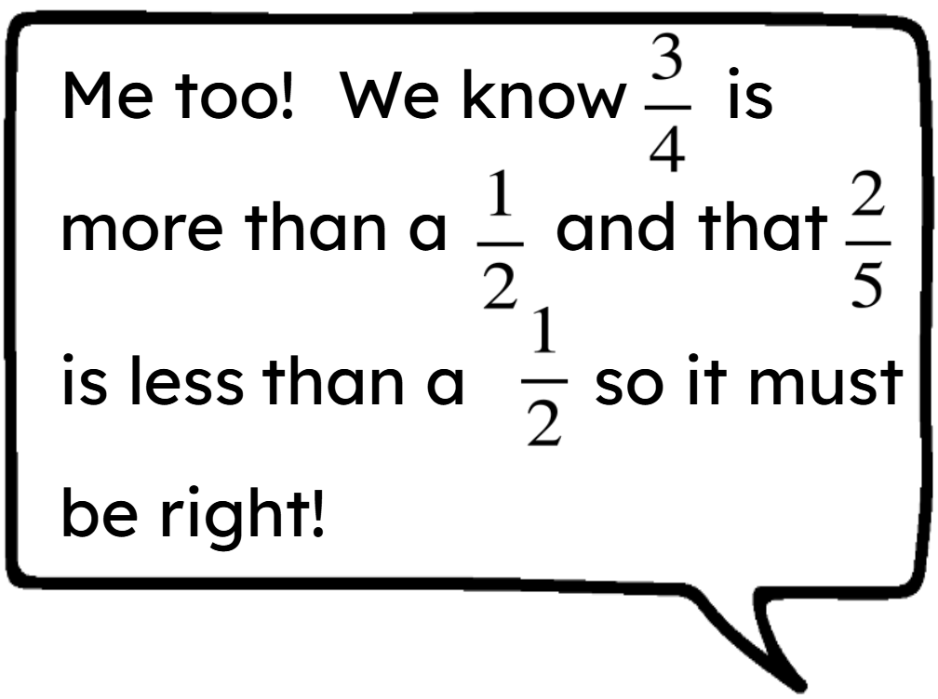
Solving problems with fractions
Arrange five different digits into this inequality.
3
2
1
>
>
4
5
I’ve just realised that there was a much easier way to check this!
Laura
Jacob

Slide 11
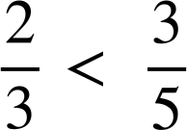

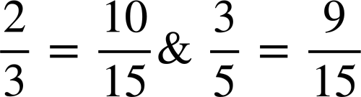
Solving problems with fractions
and
2.3 is less than 3.5

Slide 12




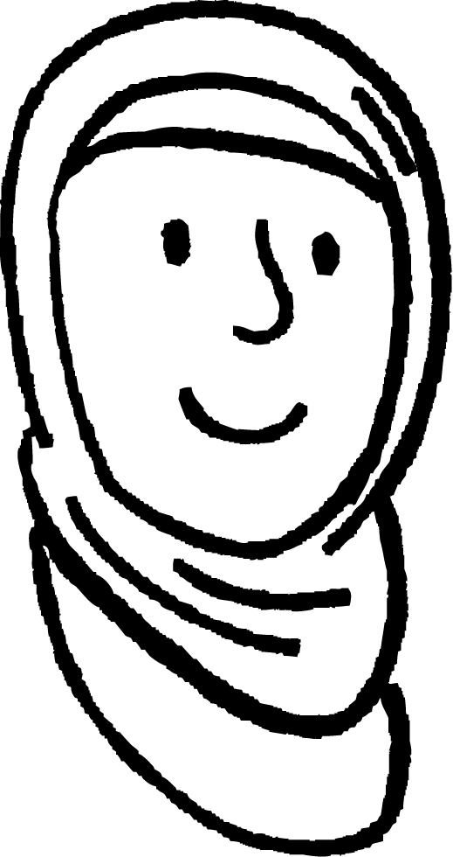

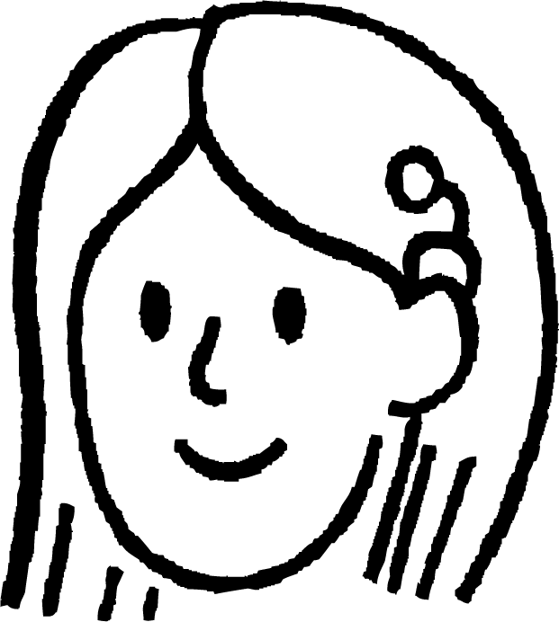
Solving problems with fractions
Aisha, Jun and Sofia each have a tub of sweets.
They count what fraction of their tubs are red sweets.
of mine are red.
of mine are red.
And
of
mine.
Aisha
Jun
Sofia
Who has the greatest proportion of red sweets?

Slide 13
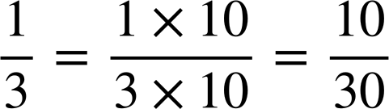
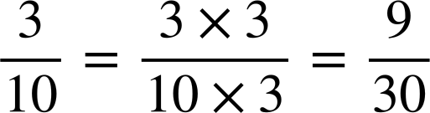
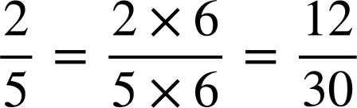
Solving problems with fractions
Who has the greatest proportion of red sweets?
What is the lowest common multiple of 3, 10 and 5?
The LCM of 3, 10 and 5 is 30.
In order from the smallest to the largest proportion of red sweets:
Jun, Aisha and Sofia

Slide 14
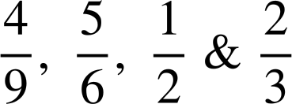
Solving problems with fractions
To compare
you would use which common
denominator?
6
12
18
27

Slide 15
Solving problems with fractions
Arrange five different digits into these inequalities.
a)
b)
>
>
>
>

Slide 16
Solving problems with fractions
2) Arrange the digits 1 to 9 to make these inequalities true.
a)
b)
>
>
>
>
>
>
>
>

Slide 17





Solving problems with fractions
3) Izzy, Andeep, Lucas, Alex and Sam record their scores for a spelling competition.
Rank them from worst to best.
Izzy
Andeep
Lucas
Alex
Sam

Slide 18
Solving problems with fractions
Arrange five different digits into these inequalities.
a)
b)
E.g.
7
9
5
>
>
2
3
E.g.
5
4
>
>
1
2
3

Slide 19
Solving problems with fractions
2) Arrange the digits 1 to 9 to make these inequalities true.
a)
b)
E.g.
8
6
4
2
1
>
>
>
>
9
7
5
3
E.g.
3
5
7
9
>
>
>
>
1
2
4
6
8

Slide 20
Solving problems with fractions
3) Izzy, Andeep, Lucas, Alex and Sam record their scores for a spelling competition.
Rank them from worst to best.
Izzy
Andeep
Lucas
Alex
Sam
Ranked:
Andeep, Lucas, Sam, Alex, Izzy

Slide 21
Problem solving with fractions and decimals
Solving problems with fractions
Solving problems with decimals
Solving problems with fractions and decimals

Slide 22
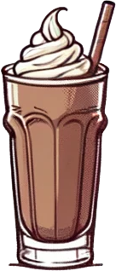
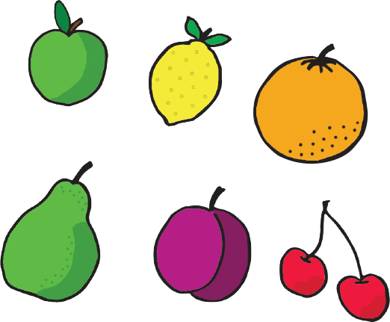
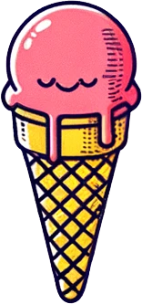


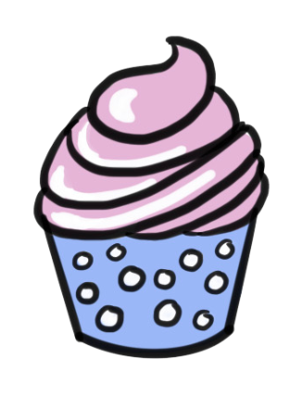
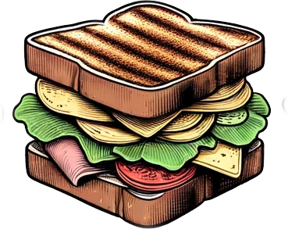
Solving problems with decimals
Write the items in order from the cheapest to the most expensive.
£0.56
£0.75
£1.24
£2.19
£1.26
£2.75
£1.84

Slide 23
Solving problems with decimals
What can you buy that would be closest to spending £5?
£0.56
£0.75
£1.24
£2.19
£1.26
£2.75
£1.84
A sandwich and an ice-cream.
Total cost = £2.75 + £2.19 = £4.94

Slide 24
Solving problems with decimals
Can you buy an apple, a cupcake, and a sandwich with £5.00?
£0.56
£0.75
£1.24
£2.19
£1.26
£2.75
£1.84
Apple £0.56
Cupcake £1.24
Sandwich £2.75
Total cost = £4.55
So, yes you can.

Slide 25
Solving problems with decimals
Here are the prices of some items in a cafe.
£1.58
£0.77
£1.95
£0.76
£1.54
£2.95
£1.98
Write them in order from cheapest to most expensive.
You have a £5.00 gift voucher but you won’t get any change.
You therefore want to spend as close to £5.00 as possible.
What can you buy?
What is the largest number of items you can buy with £5.00 and what are they?

Slide 26
Solving problems with decimals
£0.77
£0.76
£1.58
£1.95
£1.54
£2.95
£1.98
a)
b) A sandwich and a milkshake. Total cost = £2.95 + £1.98 = £4.93
c) An apple, a banana, a juice and a cupcake.
Total cost =£0.77 + £0.76 + £1.54 + £1.58 = £4.65

Slide 27
Problem solving with fractions and decimals
Solving problems with fractions
Solving problems with decimals
Solving problems with fractions and decimals

Slide 28

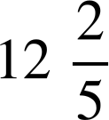
Solving problems with fractions and decimals
Laura is buying some ribbon to go around the edge of a cushion.
She gets to the shop and realises that she must have written a measurement down incorrectly.
Width
of a metre
Length
of metre
Which measurement do you think she has incorrectly recorded?
The length m. This is roughly the height of the Statue of Zeus!
Laura

Slide 29


Solving problems with fractions and decimals
She texts her mum to get the correct measurement.
Her mum says it is 0.85 m.
How many metres of ribbon does Laura need?
Width
of a metre
Length
of metre
is 0.75 m.
0.85m
So, she needs
2(0.75 + 0.85) m
3.2 metres of ribbon
Laura

Slide 30
Solving problems with fractions and decimals
How many metres of ribbon will Laura need for this cushion?
1.24 m
m
is 0.8 m
Length of ribbon needed = 2(0.8 + 1.24) = 4.08 metres

Slide 31





Solving problems with fractions and decimals
Work out the length of ribbon needed for cushions with these dimensions. (All dimensions are in metres)
Width | Length | Converted length / width | Calculation | Length needed
0.64
1.38
0.15
 | 1.07
 | 0.97

Slide 32
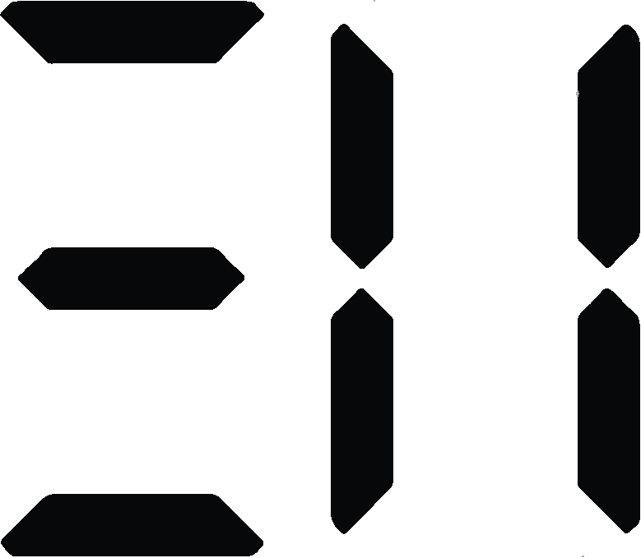

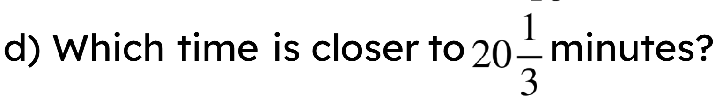
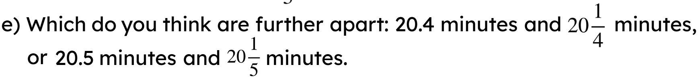
Solving problems with fractions and decimals
2) A stopwatch measures time in minutes and seconds:
a) Is this more or less than 20.5 minutes?
By how much?
b) Is this more or less than 20.3 minutes?
By how much?

Slide 33
Solving problems with fractions and decimals
Work out the length of ribbon needed for cushions with these dimensions. (All dimensions are in metres)
Width | Length | Converted length / width | Calculation | Length needed
0.64 |  | 0.45 | E.g. 2(0.64 + 0.45) | 2.18 m
1.38 |  | 0.6 | E.g. 2(1.38 + 0.6) | 3.96 m
0.15 |  | 0.12 | E.g. 2(0.15 + 0.12) | 0.54 m
 | 1.07 | 0.35 | E.g. 2(0.35 + 1.07) | 2.84 m
 | 0.97 | 0.875 | E.g. 2(0.875 + 0.97) | 3.69 m

Slide 34
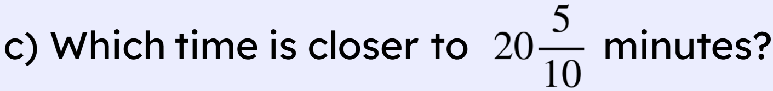
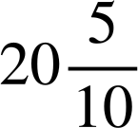
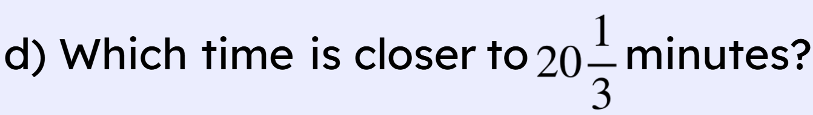
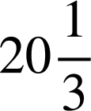
Solving problems with fractions and decimals
2) A stopwatch measures time in minutes and seconds:
a) Is this more or less than 20.5 minutes?
By how much?
It is 20 seconds more than 20.5 minutes
b) Is this more or less than 20.3 minutes?
By how much?
It is 12 seconds more than 20.3 minutes
20:30 is exactly equal to minutes.
20:30 is closer to minutes (as this would be 20:20).

Slide 35
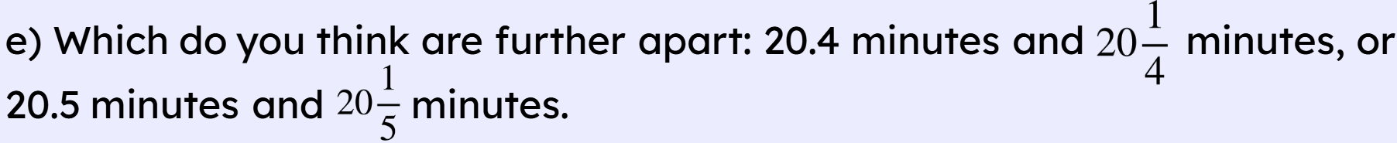
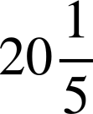
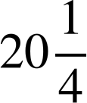
Solving problems with fractions and decimals
20.5 minutes and minutes are furthest apart. For 20.4 minutes, 20:24 would be showing and, for minutes, 20:15 would be showing. These are nine seconds apart. For 20.5 minutes, 20:30 would be showing and, for minutes, 20:12 would be showing. These are 18 seconds apart.

Slide 36
Problem solving with fractions and decimals
Fractions can be compared and ordered by converting them to decimals.
Fractions can be compared and ordered by converting them to have a common denominator.
Decimals are compared and ordered using place value.
When comparing fractions and decimals they may need to be converted into the same form.

Slide 37

© Oak National Academy 2023.
Produced in partnership with Mathematics in Education and Industry.
Licensed on the Open Government Licence v3.0, except where otherwise stated. See Oak terms and conditions.

